Slide 1
Decoding the Disciplines and Curriculum Design using Backward Design
Peter D’SENA (and with thanks to David Pace, INDIANA UNIVERSITY for many of the slides in this presentation)
september 2017

Slide 2
From Gatekeeping to Mass Education
Sorting
Educating?

Slide 3
How can we help students ‘invent the university’?
Teach them the steps that they need to master in order to succeed in the discipline

Slide 4
Expertise and Ignorance
Expertise is necessary for teaching to occur
Expertise can prevent learning
The ‘natural’ becomes invisible
To escape this dilemma we must do intellectual work to make explicit all the steps necessary to complete tasks in our discipline

Slide 5
This American Life: Alzheimer's and “Practicing the Clock”
How does one read an analogue clock?
“Superimposition of 3 Types”
Two hands
Eye goes to larger – repress that urge
When reading short hand – each unit represents one hour
Except that there are only 12
When reading the long hand -- the same units each represent 5 minutes

Slide 6
Decoding the Disciplines
Making the Hidden Curriculum Visible
Notes:
Over time we developed a process for focusing faculty attention on disciplinary thinking—and where students get stuck in that thinking and how to help them learn discipl thinking.
One Result in our book,
Collaborative effort with faculty in a FLC
And ongoing research that I will talk about later on.

Slide 7
Decoding Step 1
Begin by identifying a place in a particular course where the learning of many students is blocked

Slide 8
A Bottleneck from a History Course
Students have difficulty seeing concepts such as “family” as cultural constructs that change over time
They often view 19th century descriptions of families as straight-forward descriptions of actual conditions
Eastman Johnson, Christmas Time the Blodgett Family (1864)

Slide 9
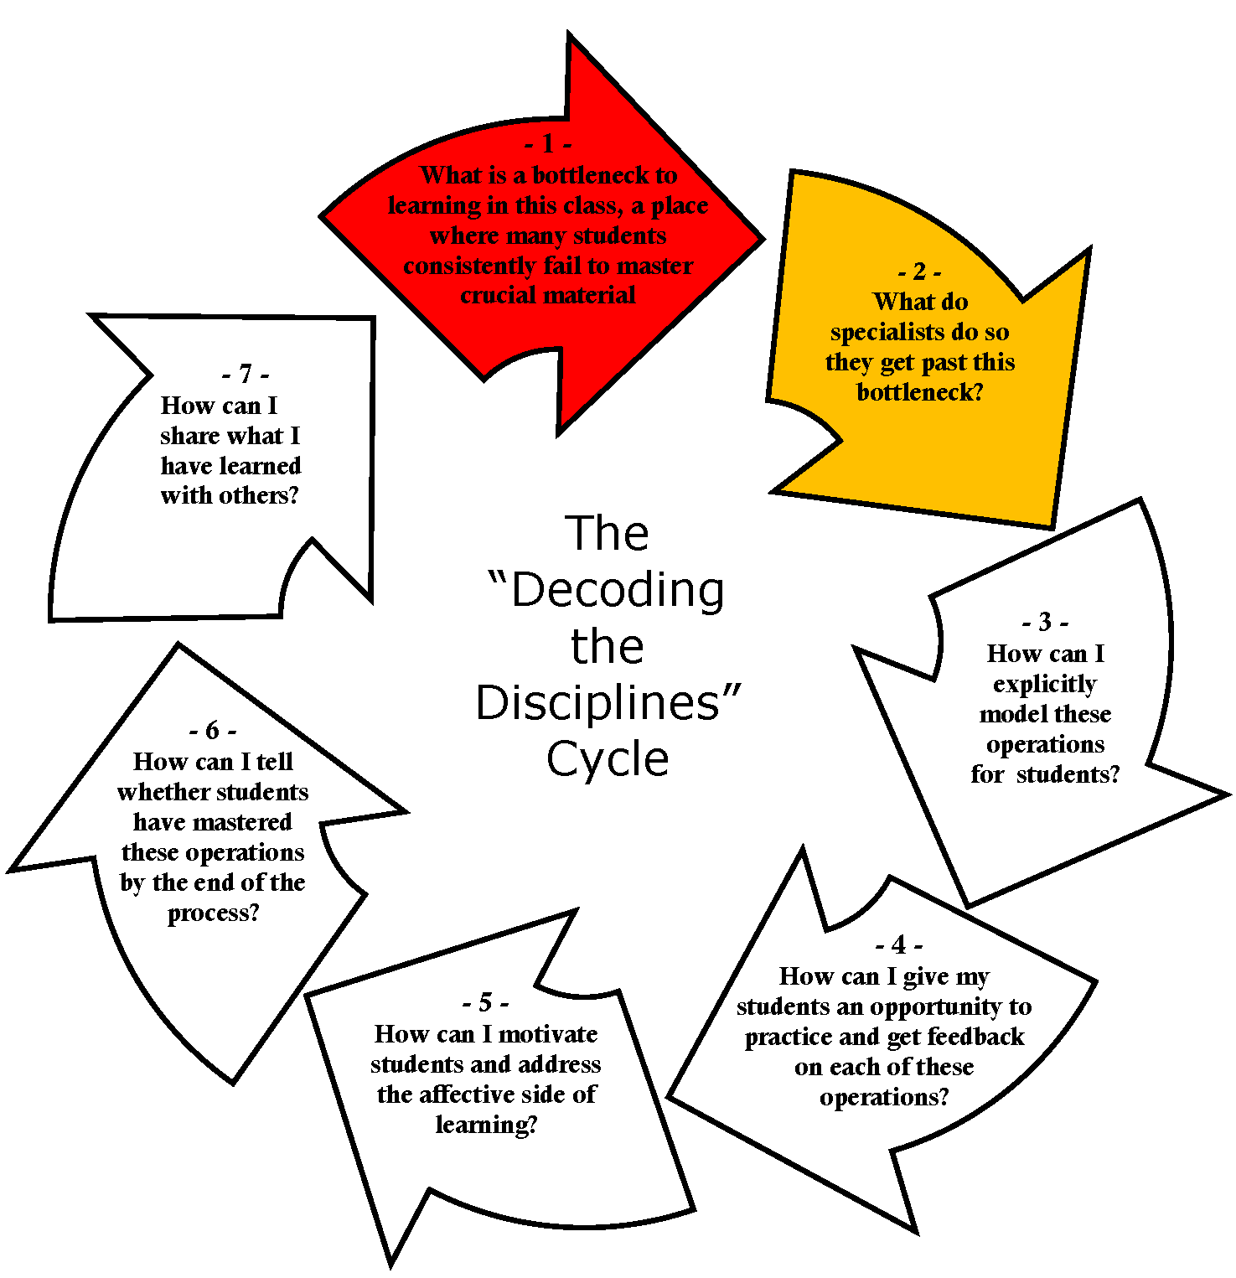
Step 2: What kind of thinking is required to get past the bottleneck?
Notes:
Step 2 is to ask what students have to do to master this bottleneck
We used to ask what an expert does, and that is useful, but experts often don’t know what they’re doing
That sounds awful! But I’ll say more about that in a minute
We use an interview process to do that, and we’re going to spend a lot of time in this workshop on this—about half

Slide 10
Step 2: Identifying Hidden Operations
Strategies for Making Implicit Disciplinary Steps Explicit
Decoding Interview (Indiana University
Self-Guided Decoding Exercise (Swantje Lahm and Svenja Kaduk, Bielefeld University)
Metaphors and Rubrics (Joan Middendorf, Indiana University)
The Collective Decoding Interview (Law School at the University of the Free State)
Student-Led Decoding Interview (Elon University)

Slide 11
The Classic Decoding Interview
Ask the expert about a specific example. “What do YOU do?”
Imagine yourself doing what they describe. Summarize what expert says; restate it. Are crucial steps being left out?
Ask questions where you don’t understand.
Probe where the expert cannot explain.
Reassure the expert.
Gently interrupt if expert talks about how they teach their students or if they start to lecture.

Slide 12
What Emerged from the Interview
A recognition of the difficulty that others face in doing what comes naturally to us as experts
Deconstructing the images of gender construction in a piece of 19th century literature does not come naturally to many students
A series of specific mental operations that students must master to get past the bottleneck
Hence, we must look carefully at what students need to do, when using sources in this module (see slide notes, below).
Notes:
Make use of some general readings strategies
Recognize that carefully reading requires multiple readings, not just passing one’s eyes over the word
Understand that a text can have multiple meanings
Look for clues that relate the text to the secondary scholarship on the topic
Ask questions about what did not happen in a text, as well as what was actually on the page
Compare the text to a series of prompts or questions
Look for contradictions and tensions within the text
Distinguish between what is and is not important in a text
Compare different sources to understand each of them better
Bring to the text some specific understandings of the nature of the historical analysis
Recognize that the text is the creation of particular people
Recognize that people in the 19th century are different than us, that they have very different assumptions
Recognize the biases that a figure from the past brings to his or her description of phenomena
Reconstruct the identity (values, attitudes, assumptions) of the person who produced the text
Consider other possible models of the phenomena being presented (in this case the family)
Adapt these general techniques to this particular text
Step back and take oneself out of the story
Ask questions about the text – why was it produced, what was its purpose, what is it arguing
Consider other possible models of the phenomena being presented (in this case the family)
Compare this source to others in order to understand each of them better

Slide 13
Step 3 – Model These Operations for Students
How can we show students how to do crucial mental operations that they have not yet mastered?

Slide 14
Information overload – evident from the clutter on this slide! Hence, it is necessary to make a choice
Recognize that carefully reading requires multiple readings, not just passing one’s eyes over the word
Understand that a text can have multiple meanings
Look for clues that relate the text to the secondary scholarship on the topic
Ask questions about what did not happen in a text, as well as what was actually on the page
Compare the text to a series of prompts or questions
Look for contradictions and tensions within the text
Distinguish between what is and is not important in a text
Compare different sources to understand each of them better
Recognize that the text is the creation of particular people
Recognize that people in the 19th century are different than us, that they have very different assumptions
Recognize the biases that a figure from the past brings to his or her description of phenomena
Reconstruct the identity (values, attitudes, assumptions) of the person who produced the text
Consider other possible models of the phenomena being presented (in this case the family)
Step back and take oneself out of the story
Ask questions about the text – why was it produced, what was its purpose, what is it arguing
Consider other possible models of the phenomena being presented (in this case the family)
Compare this source to others in order to understand each of them better

Slide 15
Then: how can we model these operations for students?
Recognize that the text is the creation of particular people
Recognize that people in the 19th century are different than us, that they have very different assumptions
Recognize the biases that a figure from the past brings to his or her description of phenomena

Slide 16
An example of how … Ask students (in teams) to make a list of the choices that were made in these two images and to indicate what these choices tell us about their creators’ notions of family

Slide 17
This student team exercise:
Models for students the kinds of mental operation that students need to bring to their analysis of a work such as … the one important in your course (Step 3)
Gives students some practice at conducting the operations themselves (Step 4)
Provides the instructor with some information about how well the students are able to perform some of the operations needed to succeed in the course (Step 5)

Slide 18
What is backward design?

Slide 19
There is a large literature (and diagrammatic representations)

Slide 20
See hand out, for this image.

Slide 21
Some brief notes about assessment
A very simple overview

Slide 22
There’s no set grid or template – design your own, but include amongst other things:
What are the Learning Outcomes (LOs)?
What you will do/how you will engage and challenge them & what resources are needed
What the students will do and how
Assessment: how will everyone know about attainment and progression?
Links to graduate attributes, employability, civic engagement, other standards, etc.

Slide 23
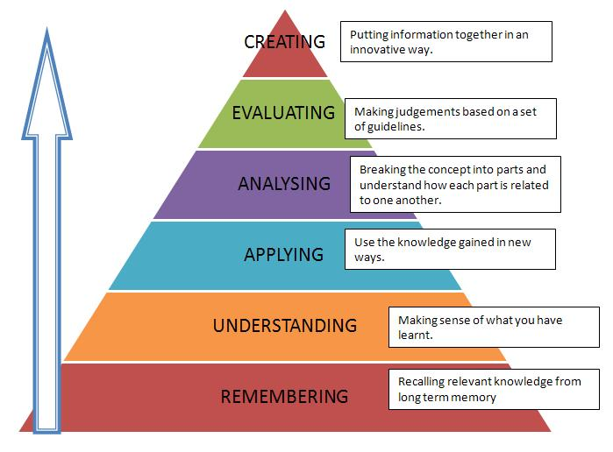
Take into account what is to be learnt. Simplified version of Bloom’s taxonomy: hierarchy of engaged learning

Slide 24
1. How can this (and other taxonomies/matrices) help to inform learning outcomes? 2. Relevance and ‘authenticity’: how can student tasks (and, ultimately, the summative assessment) be mapped against the learning outcomes?

Slide 25
Potential Learning Outcomes for Year 1 (entry level) History Degree Courses. The following ideas for learning outcomes (LOs) come from the USA.
To learn how to evaluate historical arguments on the basis of evidence drawn from historical source materials
To learn how to construct a historical argument and to make a case for it through effective presentation of evidence
To learn how to construct a historical context and interpret a primary source using that context
To understand the perspectives of people in the past
To understand and tolerate multiple scholarly perspectives
To assess habitually the origin, audience, date, genre and content of a source
To narrate, in written or oral form, an event from the past in a way that rejects inevitability
To distinguish responsible invocations of history in public discourse from specious or misleading ones
To apply historical knowledge and historical thinking to contemporary issues
To form an understanding of what is and what is not historically significant by assessing new sources, current events and students’ locales, and by asking questions about changes that affected large numbers of people in the past or had enduring consequences
To independently ask cogent questions about the past

Slide 26
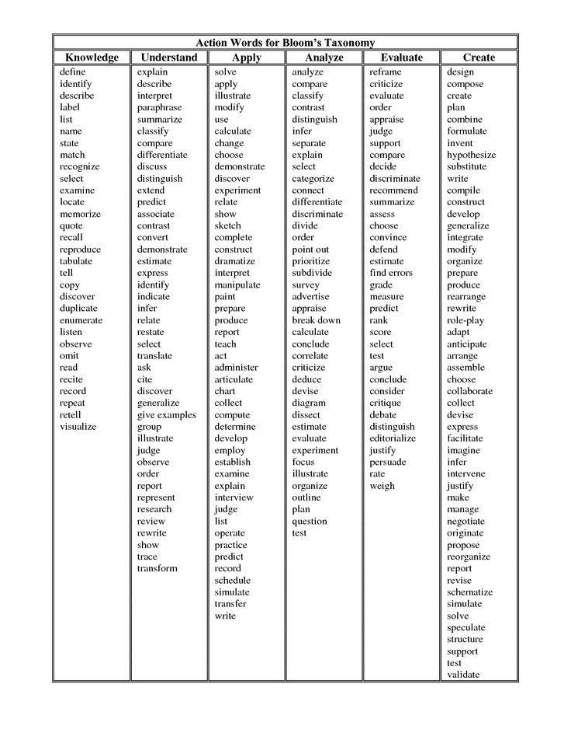

Slide 27
You decide how you want to set out your Scheme of Work
Learning Outcomes | Tutor-led | Student engagement | Assessment | Links to standards/attributes, etc. | Resources
Make the LO about the student (not you). | Can be blended – not only lecture/seminar/workshop. | What will they do: individually; in groups; in class; on site; how does it align with your intended LOs? Does it provide a ‘stretch’? | Again, ‘strategic alignment’ to what you have stated as LOs; what you have asked them to do individually or otherwise. Is it attainable and measurable? | For example: employability; the global dimension; ‘soft skills’, often seen in graduate attributes; professional or other standards; QAA benchmark guidance. | Do you need the help of others? Do you need specific learning environments? Are there technological needs? How do you assure equity of access?

