Slide 1
When what you’re looking for isn’t there: understanding the scope of the digital archive
Jennifer Batt,
University of Bristol
jennifer.batt@bristol.ac.uk

Slide 2
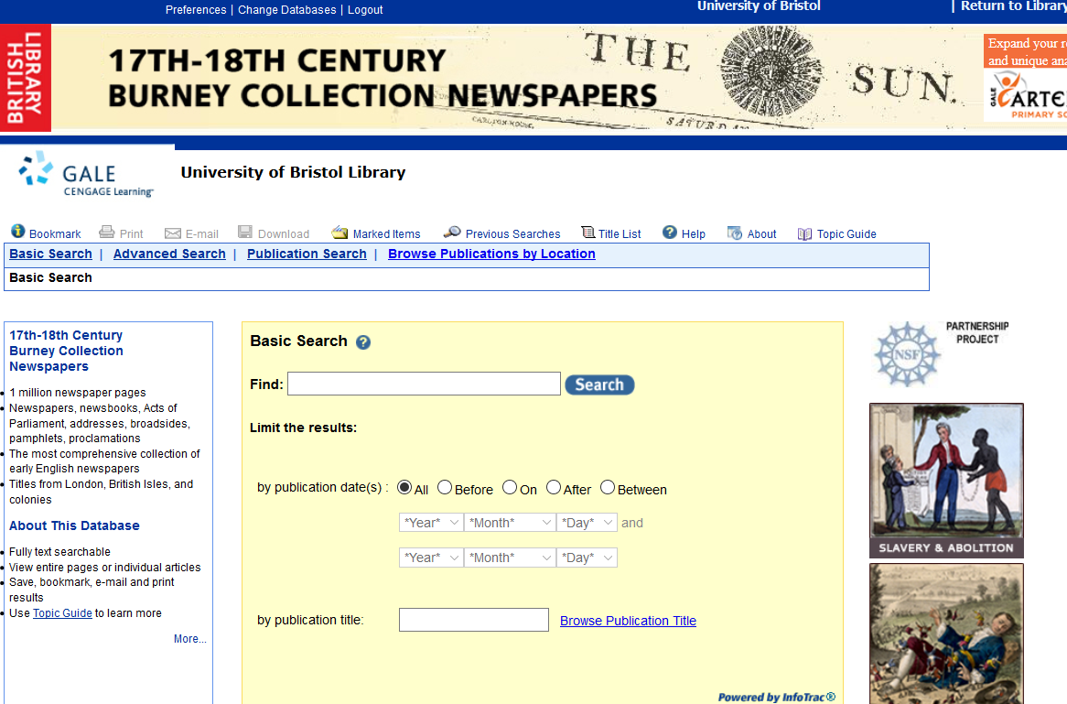

Slide 3
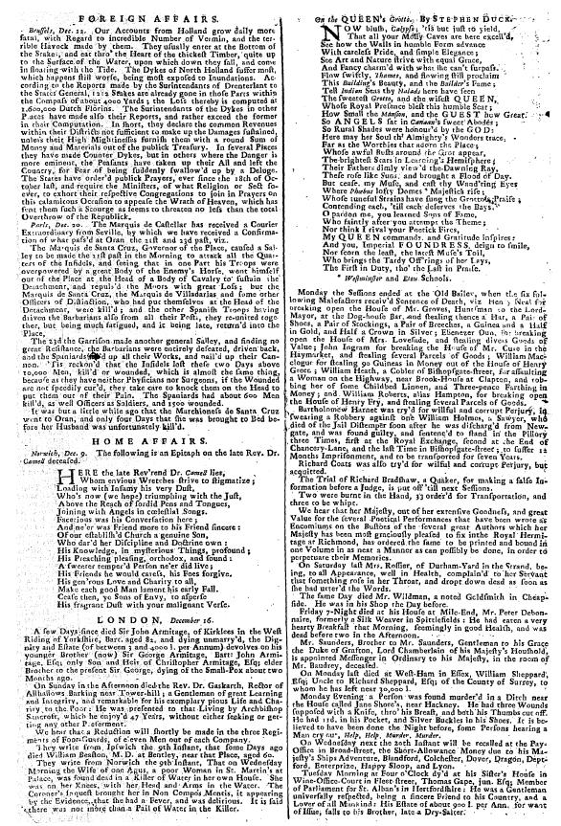
Image from LEP

Slide 4
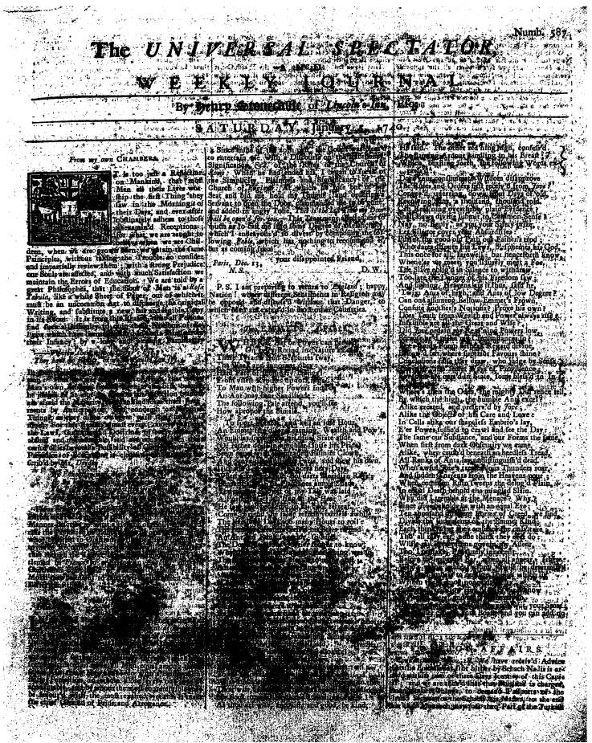
-'tor -P r W xd Thr v.: 4qd. in: Nap0e's ;n ~scwqpeuve-*ij,.~ T'rofi vt~ht Man pz~s1tp i s" i . -To Man with higher Powers int~Jg5 i's' MAai-Aa ImayA The following - -How apro'os . f: r" :4 1, 1. *Tho fWp-LtX~ . An Einmi fi r.(O). r£11zer dn 2v ! ; r i.-d ag : . , : .e I yot 4 fle , d' il a iidEPur,, LmaJpin, .Wealti andj Po~vrv', Inis uyfiz State afide,.. Ait a, gidfliew his own. deefi hierj paysq - -. dabt rts 1Ueu4ja s^ iii. re tfd,? w refifli'j allaiud: ~4., p may gurstO oui a t to~kuow . Wngvwas ' q ~rEXt~gltS 6In - audwuftf at d good,.b . ti b
Universal Spectator
5 January, 1740

Slide 5
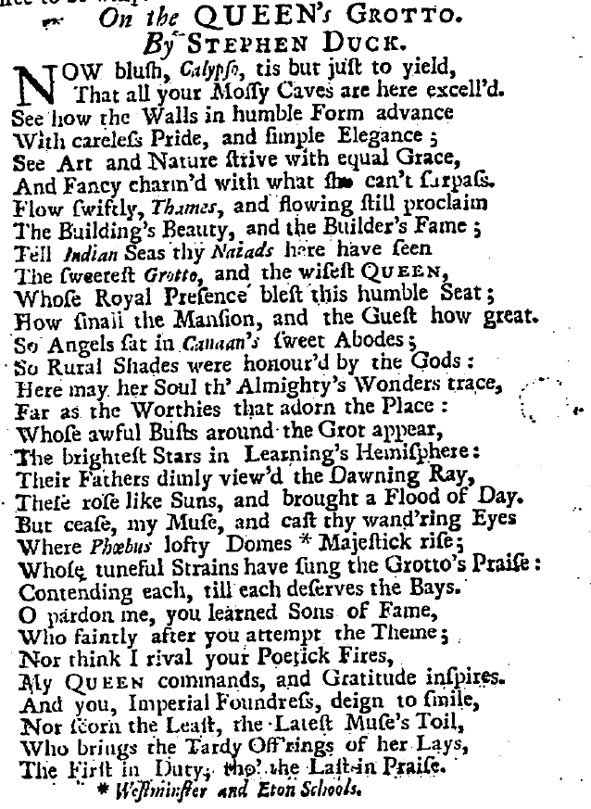

Slide 6
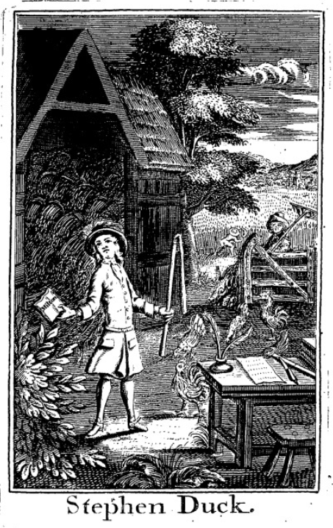

Slide 9
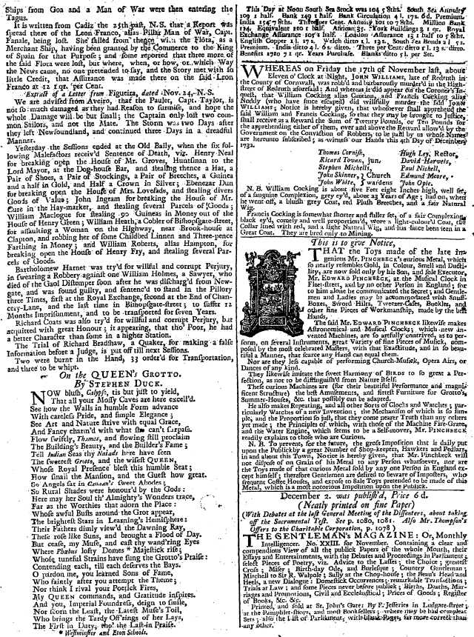

Slide 10
Image from LEP
Northampton Mercury

Slide 11
To the Author of the Whitehall Evening-Post. SIR, I Read with a great deal of Pleasure the elegant Copy of Verses, On the Queen’s Grotto, writ by Stephen Duck, and inserted in your Paper on Tuesday the 12th Instant: Give me Leave, by your Means, to offer to the Consideration of the modest and ingenious Author, only two small Alterations. No. 10. THE sweetest Grotto, and the wisest Queen. As the Word sweet occurs within two Lines, viz. sweet Abodes, perhaps it wou’d be better to read fairest Grotto. No. 21 &c. But cease, my Muse, and cast thy wand’ring Eyes, Where Phœbus’ lofty Domes Majestick rise; Whose tuneful Strains have sung the Grotto’s Praise; Contending each, till each deserves the Bays.
…..
Hoping he will excuse this Freedom, I am, SIR, His, and your humble Servant, BENEVOLUS.
Image from LEP
Northampton Mercury

Slide 12
Sir, say’d he, (giving me the paper) you shall see. Here is a short copy of verses in my name: true, I writ them, and doubtless, with some faults, but not so many as they have now. …
---Hearing him speak thus I begg’d him to give me a genuine copy, which he did very willingly. And having read it, I own his resentment seems in some measure reasonable: I therefore, Mr. BAVIUS, communicate his performance to you, (according to the author’s own desire,) which, if you will honour with a place in your paper, you will do justice to an honest man, and oblige your constant reader.
Image from LEP
Northampton Mercury

Slide 13
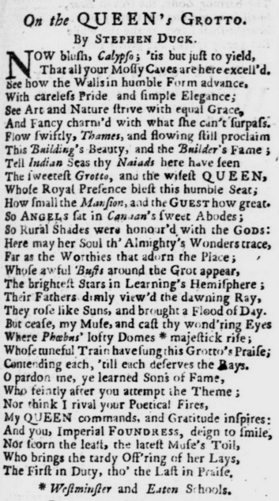
Northampton Mercury

Slide 14
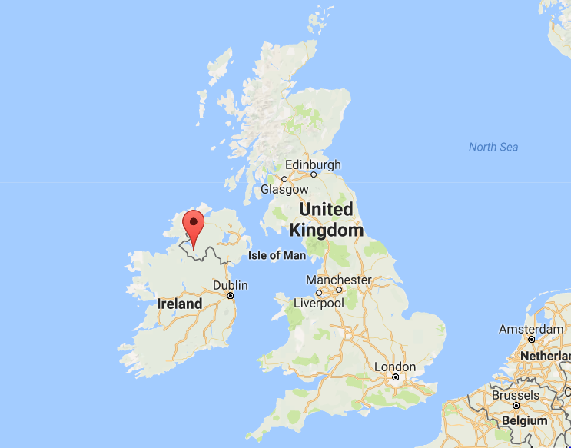
Image from LEP
Northampton Mercury

Slide 15
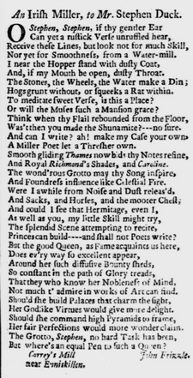
Image from LEP
Northampton Mercury

Slide 16
Image from LEP
Northampton Mercury

Slide 17
Image from LEP

Slide 19
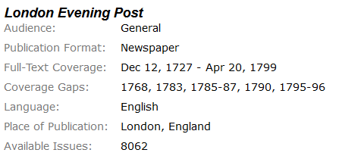

Slide 28
We require more robust methods for describing digital artefacts bibliographically: accounting for the sources, technologies, and social realities of their creation in ways that make their affordances and limitations more readily visible and available for critique.
Ryan Cordell, '"Q i-jtb the Raven": Taking Dirty OCR Seriously‘, Book History, 20 (2017) 188-225 (p. 191)

Slide 29
With particular thanks to…
Mahendra Mahey
And
Ben O’Steen
at British Library Labs

