Slide 1
Wikipedia and the Ivory Tower: a postcard from the classroom
Dr Charles West
@Pseudo_Isidore

Slide 2
Cultural Heritage
Digital Economy
Universities

Slide 3
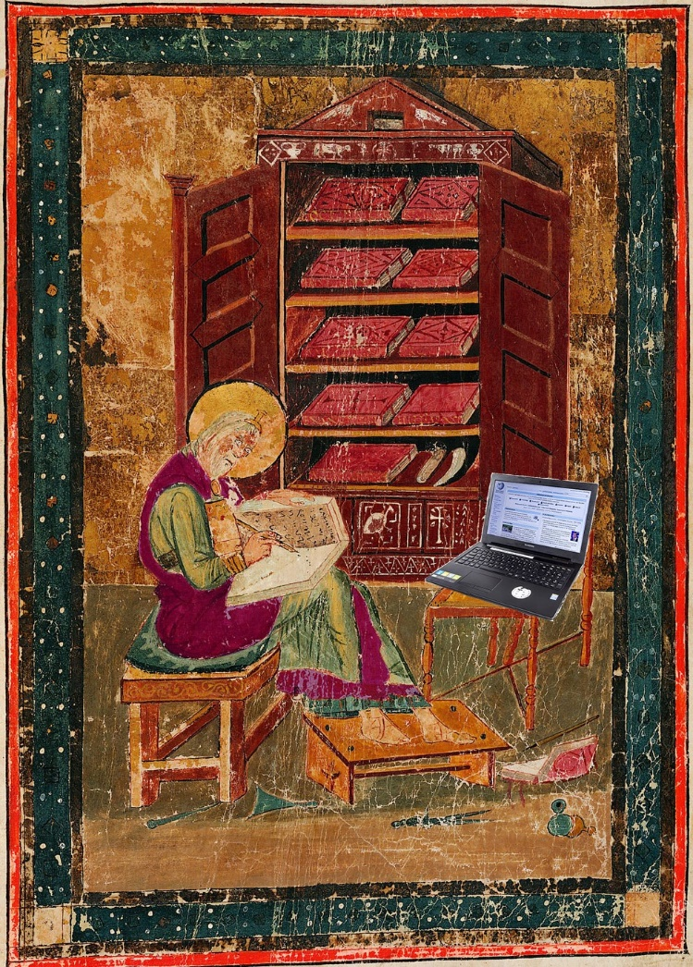
HST6089: Wikipedia and Medieval History
“Good to interact with something that seems relevant.”
“Really enjoyed this module! A completely different approach to studying history.”
Some pages we’ve created/edited
Somniale Danielis
Bernard Gui
Council of Hertford

Slide 4
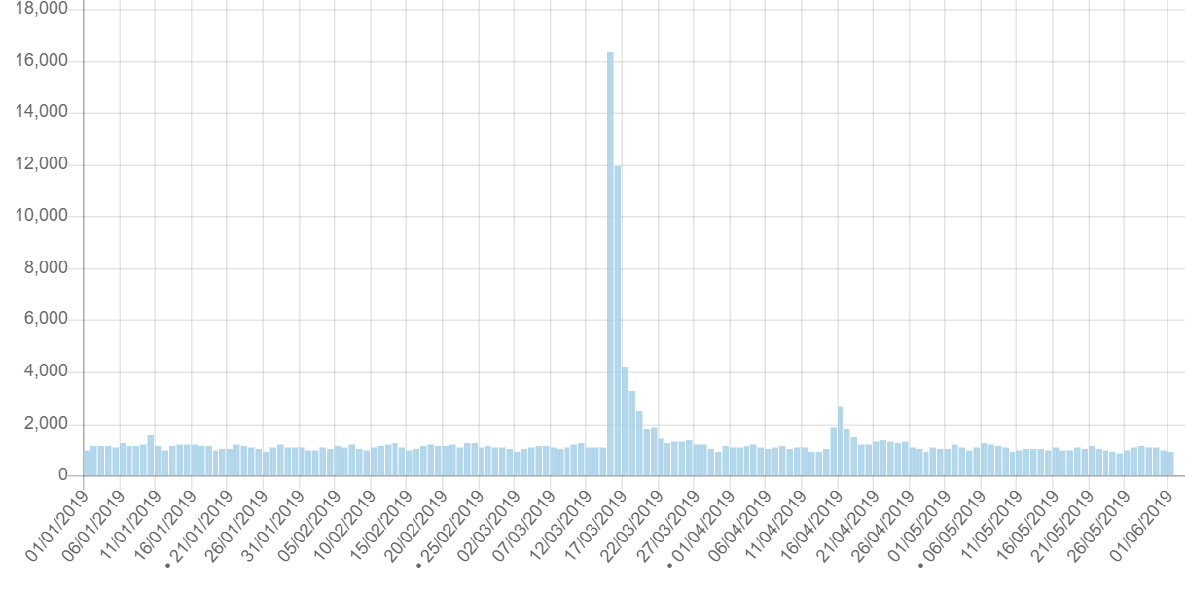
Charles Martel

Slide 5
Histropedia
http://histropedia.com/

Slide 6
Go forth and edit!

