Slide 1
Decolonising the Curriculum in Practice 15th July 2021
History New to Teaching:
An interactive workshop

Slide 2
Workshop Structure
INTRODUCTION: Dr Shahmima Akhtar and Dr Antonella Liuzzo Scorpo
What does 'decolonising' the curriculum mean?
Part 1. Decolonising the Curriculum – Sharing examples
Part 2: Decolonising your classroom/practice
Activities related to:
'Decolonising the Curriculum' - Challenges and opportunities.
Decolonising/Diversifying your bibliography
How to make your classroom/sessions (both in person and online) more inclusive and accessible?
EDI - how to get your students involved?
Q&A
Conclusion
Notes:
Introduction: A brief intro to a very broad debate, with reference to the RHS 2018 REE Report, EDI agendas in UK HEIs, accessibility and inclusion, etc.

Slide 3
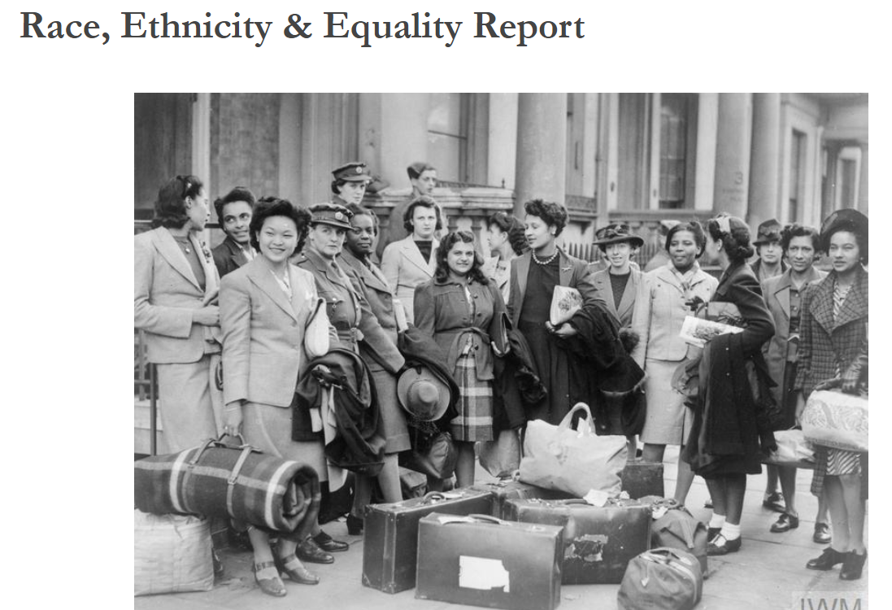
What does 'decolonising' the curriculum mean?
Notes:
Introduction: A brief intro to a very broad debate, with reference to the RHS 2018 REE Report, EDI agendas in UK HEIs, accessibility and inclusion, etc.

Slide 4
Part 1. Decolonising the Curriculum – Sharing examples
At Royal Holloway:
School of Humanities
BME Focus Group - EDI Seminar Series, BME Mentorship Scheme, Essay Prize Competition for BME A-level students, BME Working Group at School level
Toolkit on Reading Lists
ALLY
What’s next?
At the University of Lincoln:
School of History and Heritage
Revising L1 curriculum – how to get colleagues on board?
Student feedback – EDI Student Committee
Option modules: Decolonising the Past, Queering the Past.
What’s next?
Notes:
Introduction: A brief intro to a very broad debate, with reference to the RHS 2018 REE Report, EDI agendas in UK HEIs, accessibility and inclusion, etc.

Slide 5
Part 2. Decolonising your classroom– Sharing examples
At Royal Holloway:
BME Working Group – Welcome Pack
Data on attainment gap
Decolonising part of intellectual/ assessment outputs
At the University of Lincoln:
In conversation with students…
Diversifying contents and assessment strategies
A ‘safe’ space to debate, share and discuss
Notes:
Introduction: A brief intro to a very broad debate, with reference to the RHS 2018 REE Report, EDI agendas in UK HEIs, accessibility and inclusion, etc.

Slide 6
Breakout Room Discussion
Decolonising the Curriculum' - how to approach it? Challenges and opportunities.
How do you avoid decolonising the curriculum being relegated to optional modules? How could you make sure it is embedded within compulsory survey courses?
2. Decolonising/Diversifying your bibliography.
Do the case-studies and reading lists reflect diversity?
3. How to make your classroom/sessions (both in person and online) more inclusive and accessible?
Any strategies for engaging students who don’t participate as much?
4. EDI - how to get your students involved?
Any events, societies, clubs?

Slide 7
Feedback and Q&A
Notes:
https://uol.padlet.org/aliuzzoscorpo3/2menet1xpl6ymlo6

Slide 8
Bibliography
Jason Arday and Heidi Safia Mirza (eds), Dismantling Race in Higher Education: Racism, Whiteness and Decolonising the Academy (Palgrave, 2018).
Khalwant Bhopal, White Privilege: The Myth of a Post-racial Society (Policy Press, 2018).
David Bryan, Katherine Dunleavy, Keri Facer, Charles Forsdick, Omar Khan, Mhemooda Malek, Karen Salt and Kristy Warren, Common Cause Research: Building Research Collaborations between Universities and Black and Minority Ethnic Communities (University of Bristol and AHRC, 2018).
Higher Education Policy Institute (HEPI), Institutional Diversity in UK Higher Education (2012).
Jess Moody, ‘Time to Talk about Race Equality’, Wonkhe (24 June 2018): https://wonkhe.com/blogs/time-to-talk-about- race-equality/.

Slide 9
Thank you!

