Slide 1
Jamboarding in Seminars
Lucinda Matthews-jones
Liverpool John Moores University
@luciejones83

Slide 2
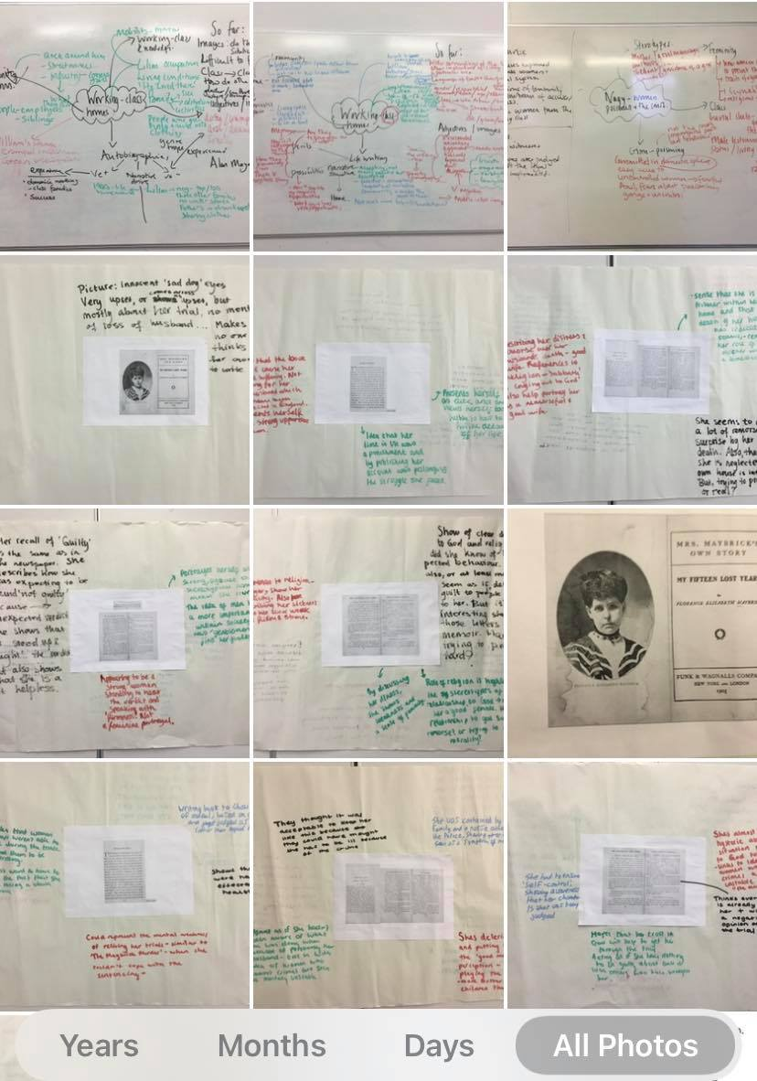
The Paper and Pen Historian

Slide 3
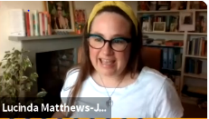

Slide 4
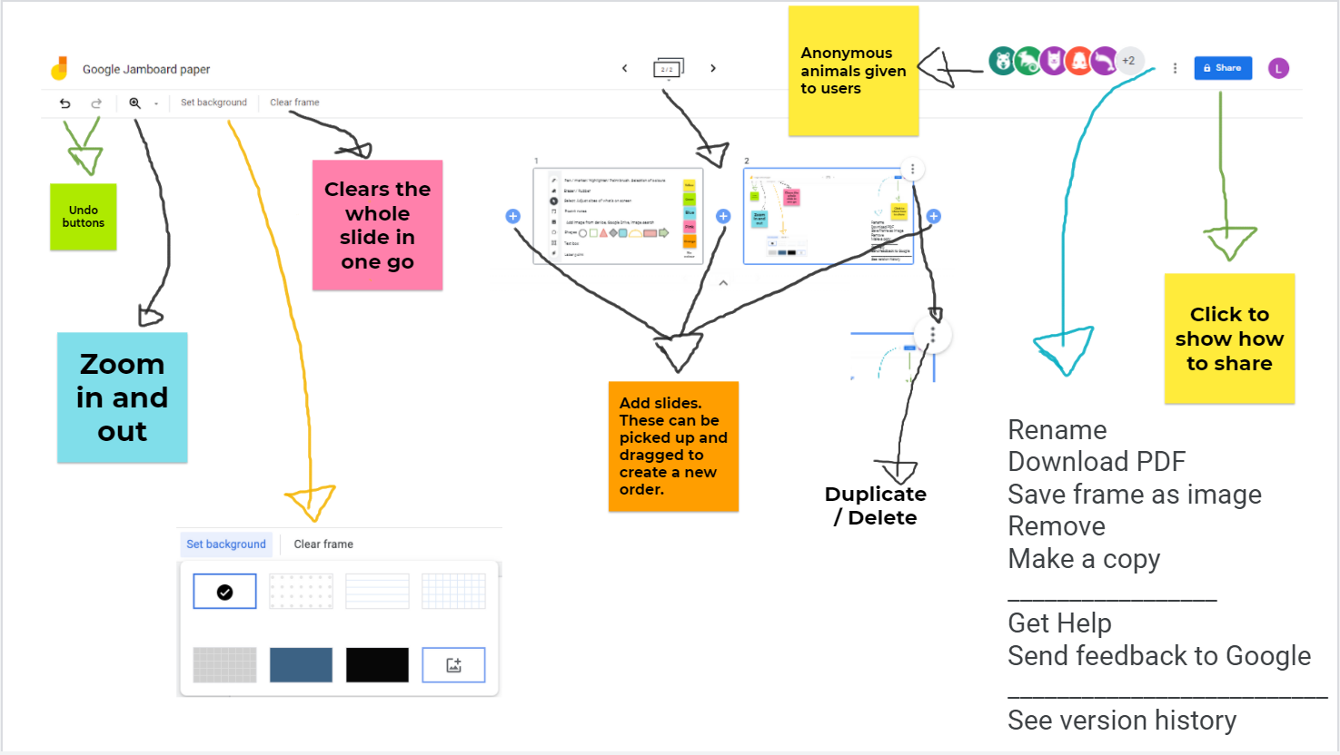
Google Jamboard Features

Slide 5
Survey
19 responses (over two-week period 1-14 June 2021)
Ages: 26-35 = 5; 36-45 = 9 / 46-55 = 5
5 Respondents (31%) said Google Jamboard was ‘collaborative’ / 3 (19%) ‘Interactive’
4 respondent (25%) it was easy / 3 respondents ‘intuitive’ / 2 respondents ‘straightforward’
2 respondents (13%) found it ‘frustrating’ / ‘sometimes frustrating’

Slide 6
How useful did you find Google Jamboard?
Did not use
7.53%
Average
(1 = no impact; 10 = a significant impact)
56% rated Google Jamboard in the 8-10 bracket for usefulness.

Slide 7
Why Google Jamboard? Class experience/ students
Some used Google Jamboard with other Virtual Whiteboards but many noted other boards were clunky and hard to take to breakout rooms.
During Class
More collaborative tool (R13) / that builds in structure (R17)
‘For me: the overview modes give a view of student progress through a set of boards’ (R1)
Dynamic experience- editing and working together in real time
‘It broke the ice’ (R5)
‘Glean answers’ from students who don’t speak (R7) / ‘Students felt empowered to contribute if they had already entered their response’ (R7) / ‘Students who didn’t want to speak in class (or couldn’t) could participate’. (R17)
Fun, playful tool that lowers stakes (Shannon Draucker; 2021)
After class
Download Jamboard session into PDFs to share (R9) / Return to Jamboards after class if they have the link

Slide 8
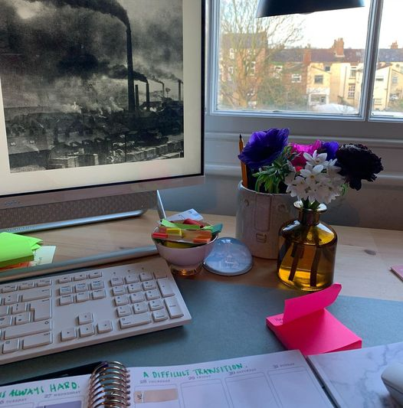
Why Google Jamboard? You, the teacher
‘Transformative! It made my teaching a more productive experience’ (R13)
‘It saved my life! I’m a quiet, introverted scholar who struggles with face-to-face teaching’ (R19)
Loss of embodied learning cues
A part of the learning experience

Slide 9
How was Google Jamboard used?
Annotation of texts (R1 / R13)
Independent collage work (R2)
Setting up breakroom tasks and presenting ideas in a larger group setting (R4/ R5/ R9)
Questions and prompts on weekly reading/brainstorming (R8/ R4/ R12/ R18)
Source Analysis (R7)
Group task reviewing (R15 / R16)
‘to make lectures more interesting and demonstrate various points’ (R11)
asynchronous prep activities

Slide 10
Things to consider
Accessibility: White background / Colour blind students
Technology: students on phones
Time to set up and get students used to how it works
Functionality i.e.
Only 20 slides
Support / data rules of the university.
How does this move into the face-to-face classroom?

Slide 11
Setting up and framing the seminar
Left: Slide to show community building task. Individual. Right: Lecture summary. Sent to break out rooms

Slide 12
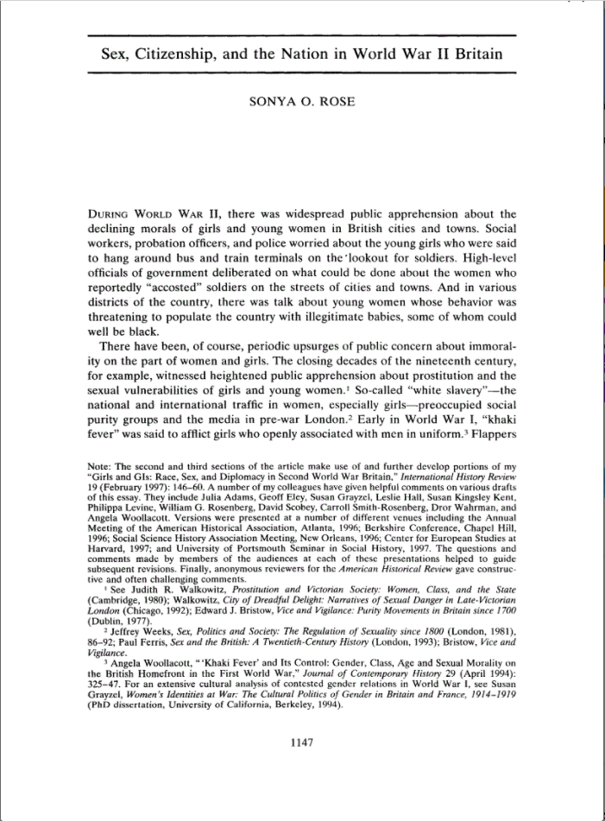
Example: Reading templates (L4)
Asked students to identify three themes
Each group then followed their theme through the article

Slide 13
Example: Reading Questions (L6)

Slide 14
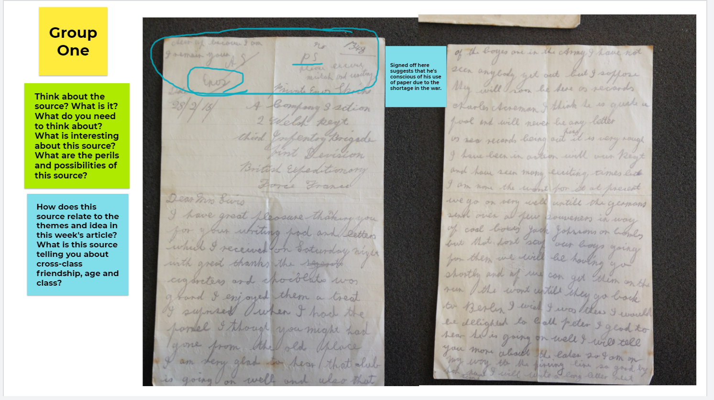
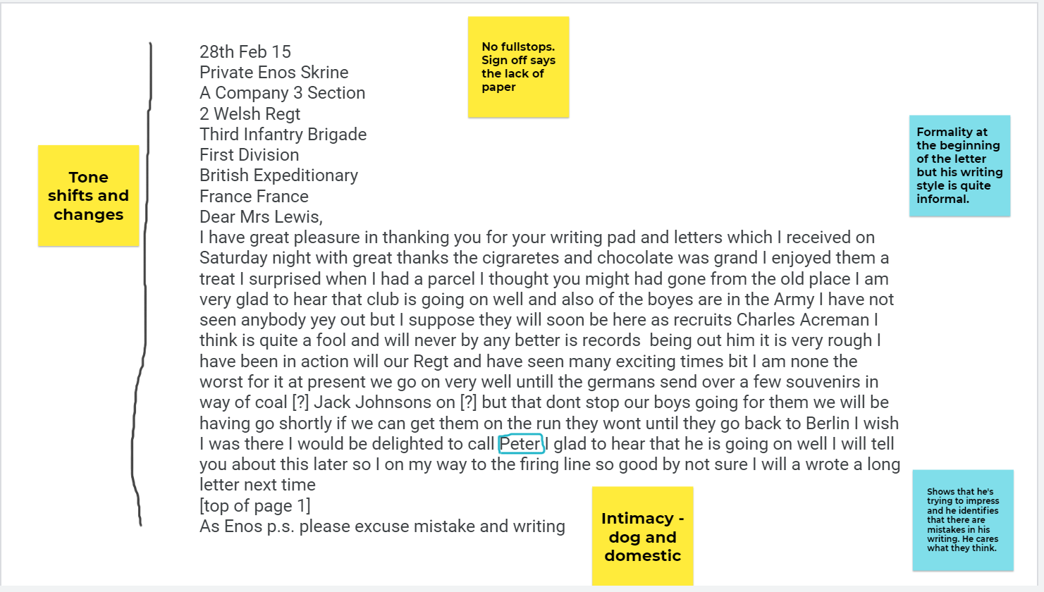
Example: Primary Source Work (L4)
In pairs students read and worked on primary sources that related to their seminar reading

Slide 15
Example: Primary Source Work

